Slide 1
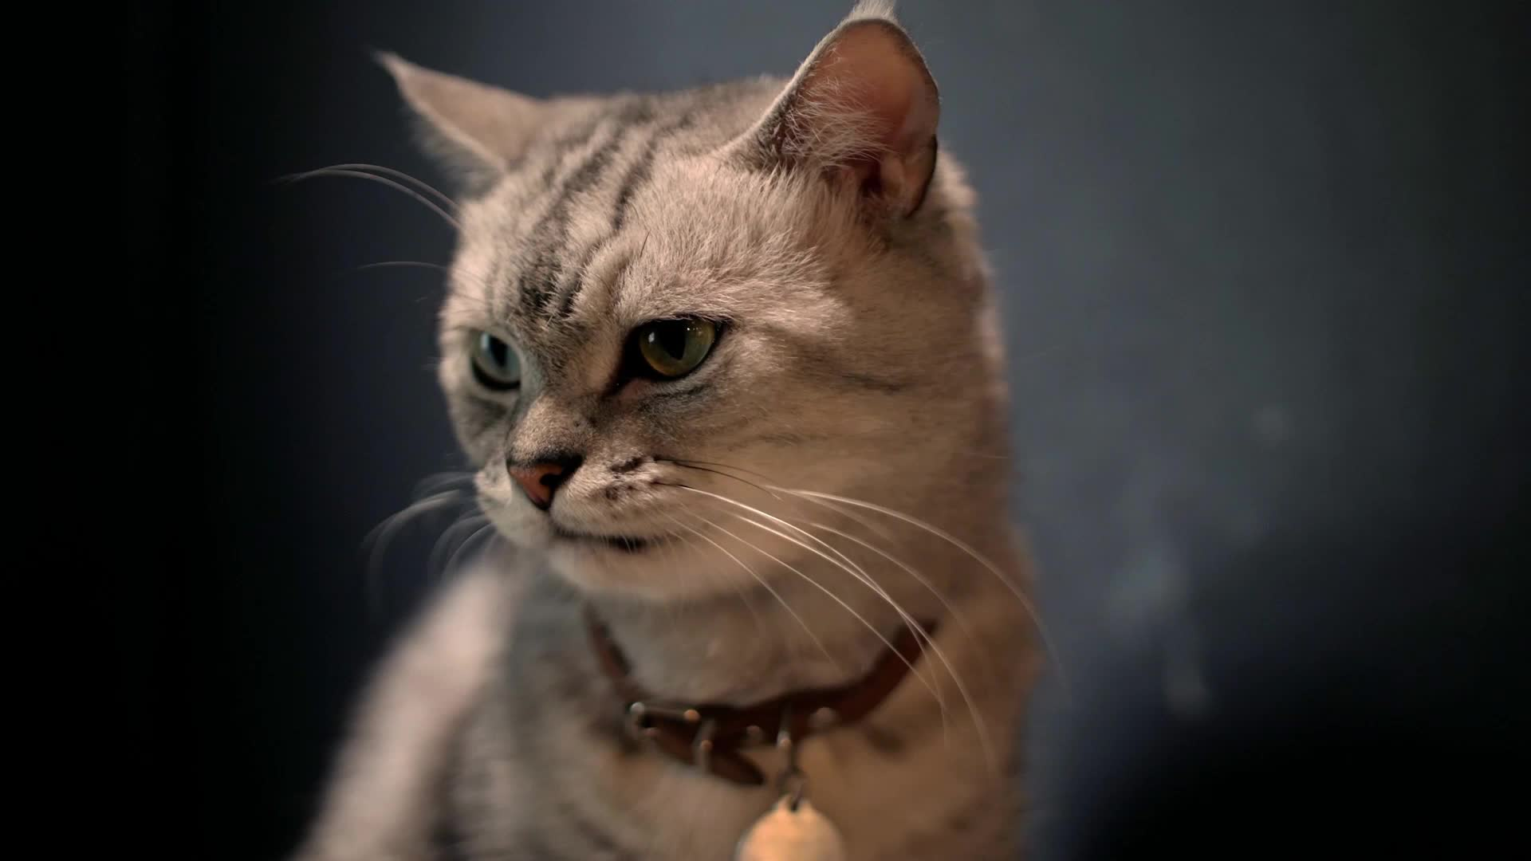
Good morning (or good afternoon)
I have survived. Thanks for saving me

Slide 2
Purpose of this questionnaire
We take BS1009 and your journey through Python programming and computational thinking very seriously
To this end, we have asked for your feedback, to identify strengths and weaknesses of the course
We will use your feedback to identify course components that need introducing, removing or adjusting

Slide 3
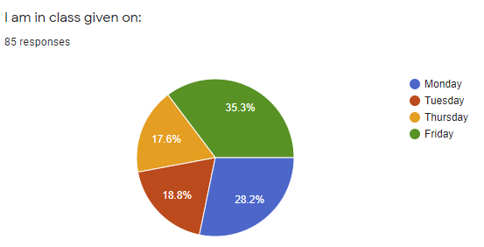
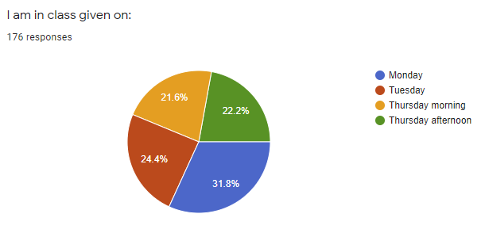
Class participation in the questionnaire
2020: ~1/3 of your replied to the questionnaire.
2020
2021: ~2/3 of your replied to the questionnaire.
(the kittens thank you)
2021

Slide 4
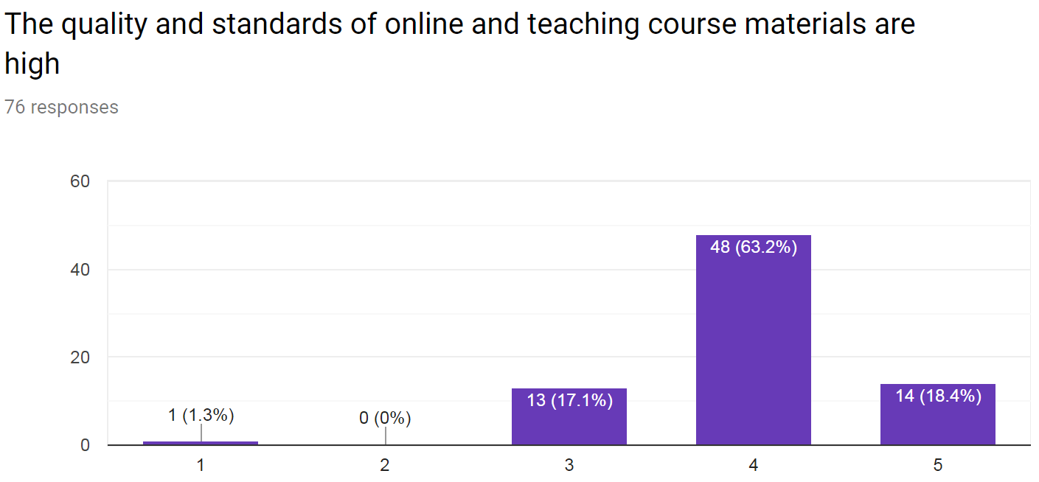
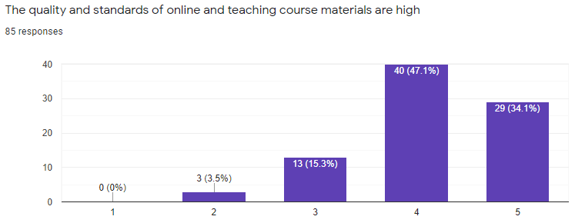
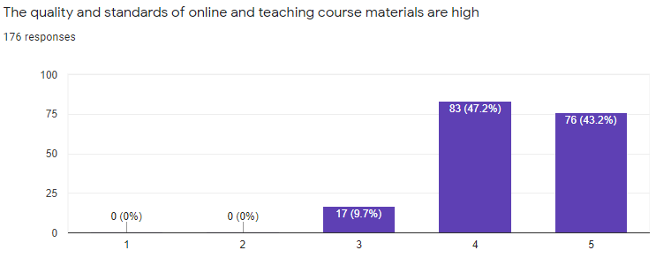
Quality of online materials: 2019, 2020, 2021
2019
We observed a steady increase in your satisfaction with online materials since 2019.
In 2020: Based on the request from students from 2019, we have added example videos at the end of the LAMS sequence.
In 2021: We have remade the lab materials to be more in line with biology. We also collated all the exercises into one Colab notebook.
2020
2021
Strongly disagree
Strongly agree

Slide 5
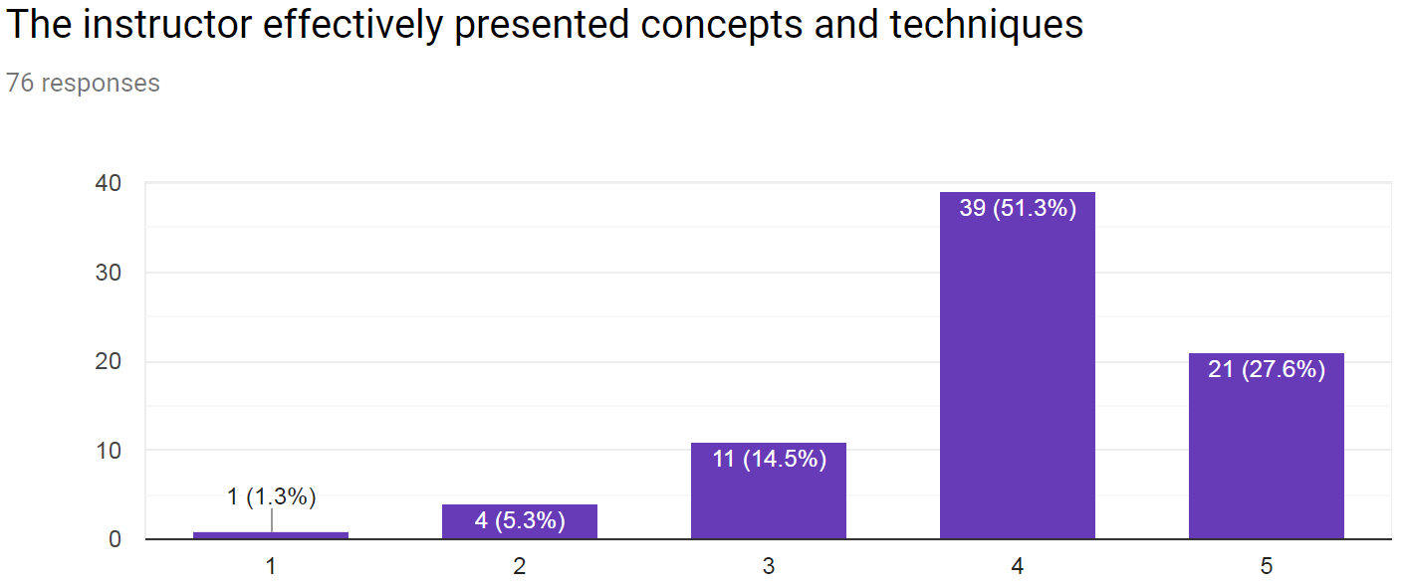
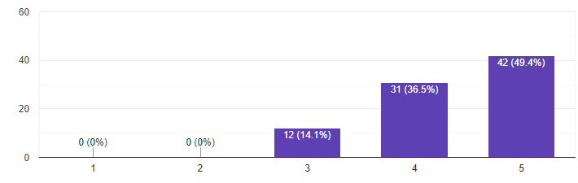
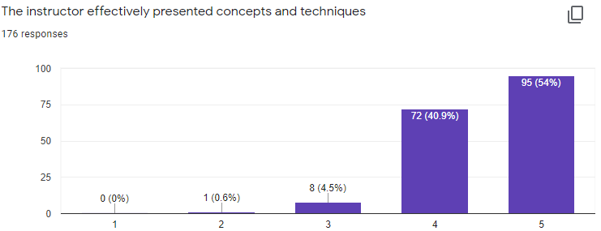
Instructors presented concepts and techniques clearly
2019
2020
It seems that we are getting better are presenting the concepts and techniques, every year.
Great!
2021
Strongly disagree
Strongly agree

Slide 6
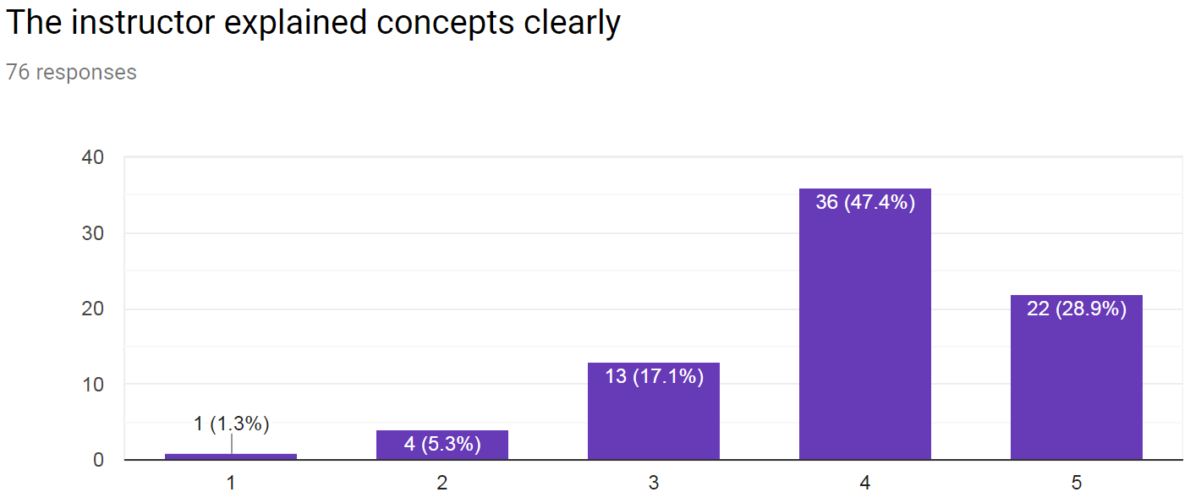
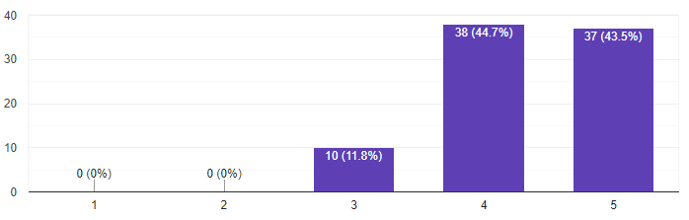
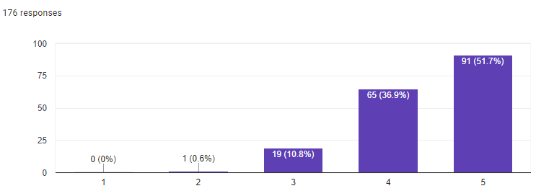
Instructors explained concepts clearly
2019
2020
Similarly, we have gotten better are explaining the different concepts.
2021
Strongly disagree
Strongly agree

Slide 7
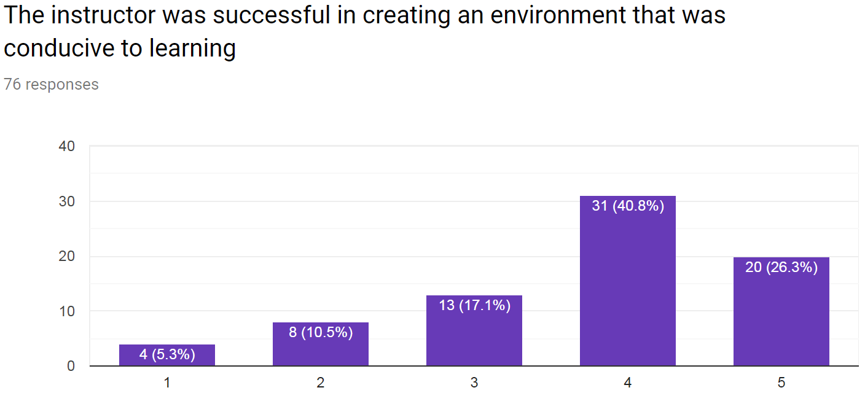
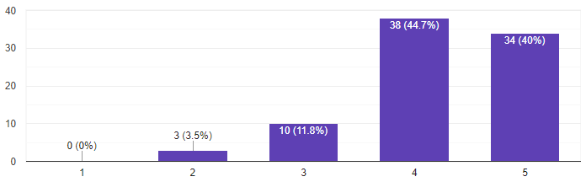
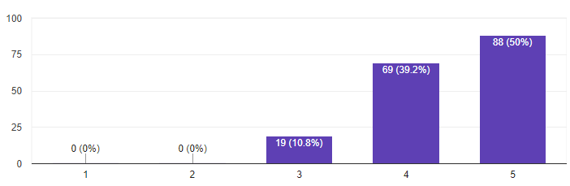
The instructor was successful in creating an environment that was conducive to learning
2019
2020
We also see an improvement in setting up the learning environment, despite the split classrooms.
2021
Strongly disagree
Strongly agree

Slide 8
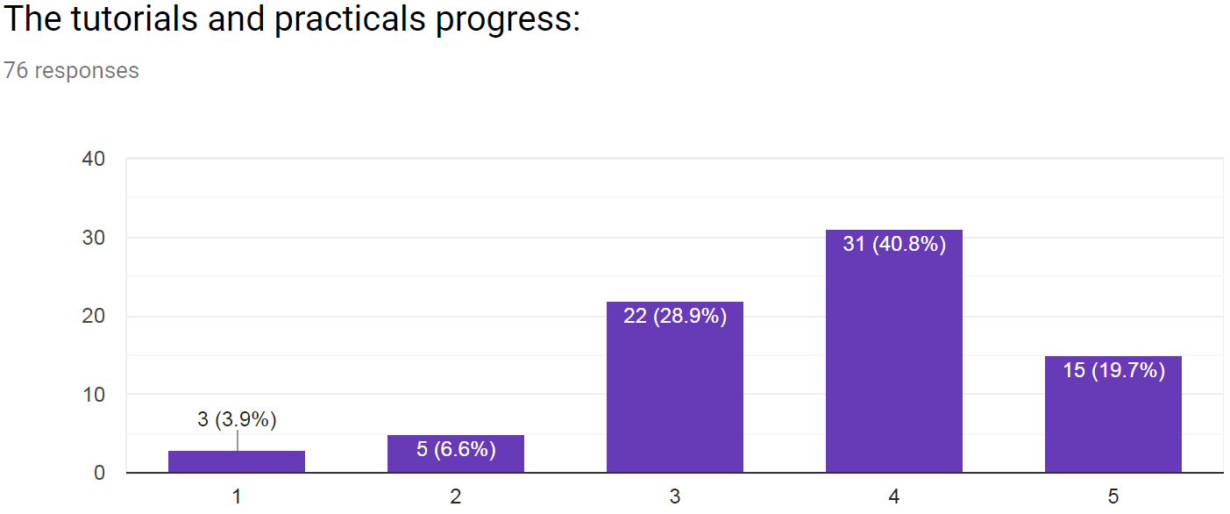
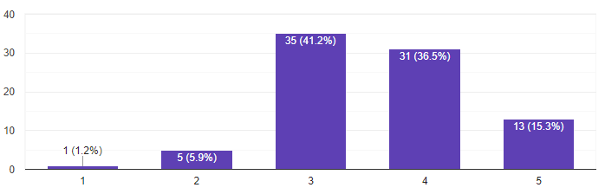
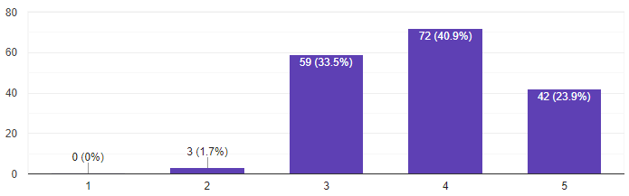
2019
The tutorials and practicals progress:
2020
Many of you think that our tutorials are still too fast, and it seems we have not improved since 2020.
We do our best to probe the class if something is unclear, but please keep in mind that we often get 0 feedback from you during the class.
But good to see that the numbers look better this year!
2021
Too slow
Just right
Too fast

Slide 9
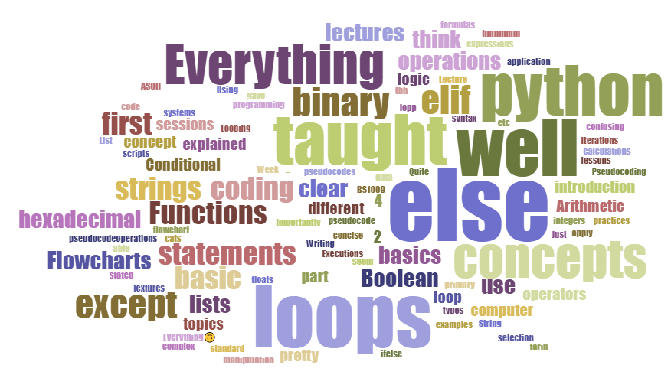
Please list the concepts that you felt were particularly well taught:
We do not see any one topic that you think was particularly well taught. It seems that this is a matter of personal taste.

Slide 10
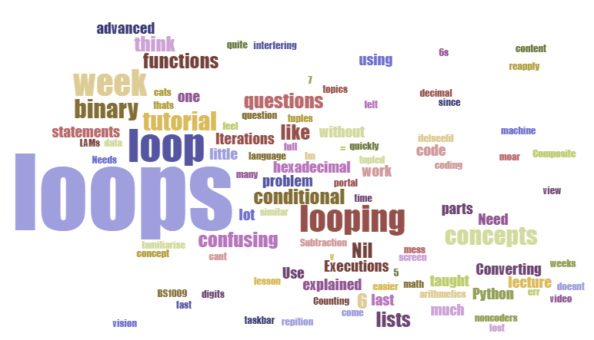
Please list the concepts that you felt needed extra work to make more clear:
It’s pretty clear that loops is something we should make more effort to explain better.

Slide 11
A frequent comment is: go more slowly
go slower
speed up the explainations
slow down the pace
Go slower
go through the practice questions slowly and provide solutions
Progress more slowly
thought process not communicated clearly and need slow down for better understanding
I think he should have consultation slots
giving python crash courses every 2-3 weeks
go through lab exercises after we try them
I felt that the class sizes was a bit too large. So the professor wasn't particularly engaging even with his enthusiastic nature. Especially across the zoom call.
more cat pics
provide more help for tougher concepts
perhaps give out more practice :))
have more qns to practice
More examples and answers
More in class practices
More hands on labs and tutorials.
I would like to have more question banks that i can practice on my own time to fully grasp the concepts
Less examples and more explanations?
include more practices to take back home
More examples
In your opinion, how can the instructor make this class better so that you can learn more effectively?
Some suggestions to alter the course
Another frequent comment: more examples and exercises

Slide 12
In your opinion, how can Teaching Assistants help you more during the practicals?
They are great
Theyre doing good
they were good
They're fine
Teaching assistants explains the content very well
They are good
Ask if we need help
maybe walk around to ask if anyone needs help
approach the students if they seem stuck?
I think the TAs are going a great job just that we need to reach out to them more for help.
Would be good if they went through what the lecturer missed or do not have much time to go through, especially the qns and concepts towards end of lessons which is quite rushed
they can ask students if they are doing okay while they are going around
Walk around
They are already pretty cool. Maybe ask students around if they need help. We can be introverts.
This year, we have many more TAs to help out (in 2020, we had 3-4 TAs per class), and many of you appreciate them. Great!
One common comment is that the TAs should reach out to you to see if you need help.
My answer: please ask for help when needing it.

Slide 13
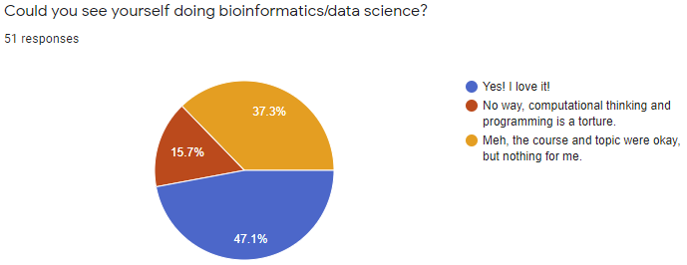
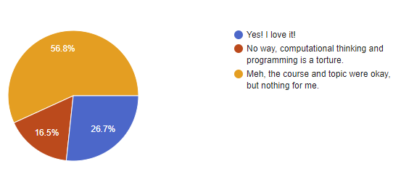
Could you see yourself doing bioinformatics/data science?
2020
We were unsure how the biology students perceive a course that teaches programming and the abstract concepts of computational thinking.
We are happy to see that 1/4 of you are enthusiastic about bioinformatics and data science. This is great, as biology is becoming more and more about big data, and there is a shortage of people who are able to make sense of it. Not to mention that programming is an invaluable skillset outside of biology!
Despite the increase in positive perception of the materials and over effectiveness, we see a decrease of enthusiasm for bioinformatics/data science since last year…? That is fine and we hope that you will keep in mind the concepts covered in BS1009, as it might become useful at some point during your studies and career.
Some of you equate it to torture. Well, I guess it’s good that only ~1/6 of you feel that way ;)
2021

Slide 14
Open session with the class
Questions for discussion

Slide 15
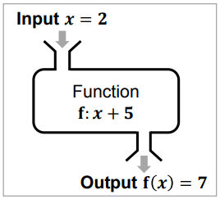
Functions: simplifying your code and making your life easier
Objective: find you how many instances of a given character there are in a string.
Without a function
#how many “a”s in banana
counter = 0
for ch in 'banana':
if ch == 'a':
counter += 1
print(counter)
#how many “e”s in pineapple
counter = 0
for ch in 'pineapple':
if ch == 'e':
counter += 1
print(counter)

Slide 16
Functions: simplifying your code and making your life easier
Objective: find you how many instances of a given character there are in a string.
Without a function
With a function
#how many “a”s in banana
counter = 0
for ch in 'banana':
if ch == 'a':
counter += 1
print(counter)
#how many “e”s in pineapple
counter = 0
for ch in 'pineapple':
if ch == 'e':
counter += 1
print(counter)
def char_counter(string, character):
counter = 0
for ch in string:
if ch == character:
counter += 1
return counter
#how many as in banana
print(char_counter('banana','a'))
3
#how many es in pineapple
print(char_counter('pineapple','e'))
2

Slide 17
Characteristics of functions
Specialization
1 function performs only one task
Modulation
Functions can be modulated to change their outputs ()
Compartmentalization
Functions allow code to be assembled like lego blocks
Scoping
Variables in a function cannot be accessed outside

Slide 18
Specialization
A function should ideally perform only 1 task
For example, the max() function returns the item with the highest value, or the item with the highest value in an iterable.
x = max(5, 10)

Slide 19
Modulation
The range() function returns a sequence of numbers
By default, it starts from 0 and increments by 1
However, you can change (modulate this)
range(3, 20, 2)
range(3, 20)
range(20)

Slide 20
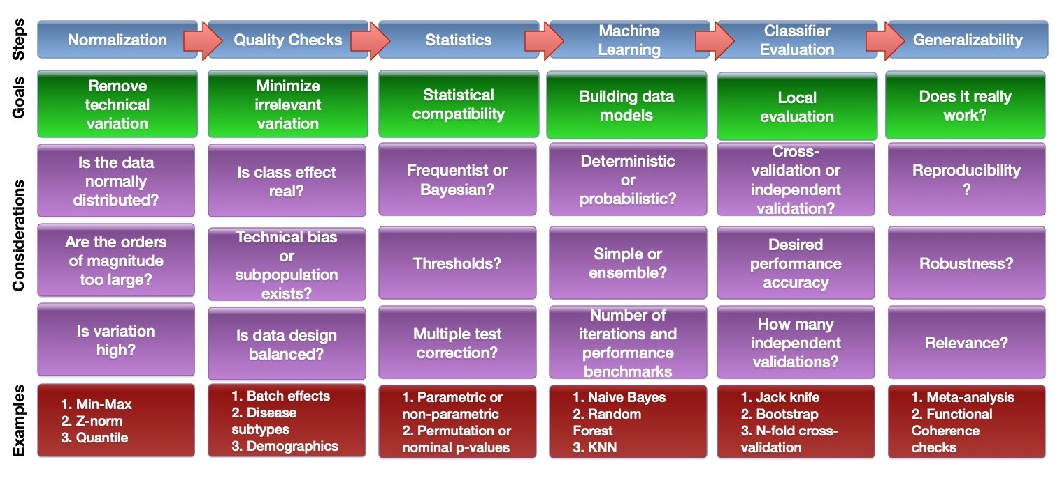
Compartmentalization
You can write code mostly comprised of functions
This allows you to separate the analysis cleanly from the algorithms

Slide 21
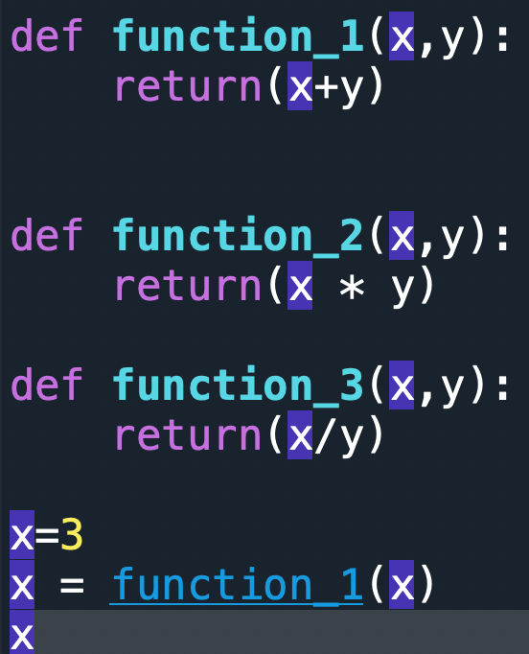
Scoping
If you are one of those people who have limited memory or creativity, scoping can help you
Scoping allows you to use ”very” generic variable names again and again.
As long as these variable names are inside the function, it cannot be accessed elsewhere in the code

Slide 22
Ready?
Now let’s start the tutorial proper

Slide 23
1. Write a function calcrectarea that will calculate and return the area of a rectangle. Test the function by passing the length and width to the function as input arguments and printing the corresponding output. (Lecture notes: p. 11)
Example:
print(calcrectarea(10,4))
40
What do we know?
Two inputs as arguments are required --- length and width
The function name should be called calcrectarea
A return call is needed to provide the calculated area
You initiate a function using def
Notes:
5 mins

Slide 24
1. Write a function calcrectarea that will calculate and return the area of a rectangle. Test the function by passing the length and width to the function as input arguments and printing the corresponding output. (Lecture notes: p. 11)
Example:
print(calcrectarea(10,4))
40
Syntax:
def char_counter(string, character):
counter = 0
for ch in string:
if ch == character:
counter += 1
return counter
Notes:
5 mins

Slide 25
1. Write a function calcrectarea that will calculate and return the area of a rectangle. Test the function by passing the length and width to the function as input arguments and printing the corresponding output. (Lecture notes: p. 11)
Example:
print(calcrectarea(10,4))
40
def calcrectarea (length , width):
""" This function calculates the area of a rectangle
Format of call : calcrectarea ( length , width )
Returns the area """
return length * width
print(calcrectarea(10,4))
Notes:
5 mins

Slide 26
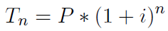
2. If a certain amount of money (called the principal P) is invested in a bank account, earning an interest rate i compounded annually, the total amount of money Tn that will be in the account after n years is given by:
Write a function called totMoney that will receive input arguments for P, i, and n, and will return the total amount of money Tn. Also, give an example of calling the function, printing in a sentence the inputs and the output of the function.
For example, with parameters:
my_principal = 10000
my_interest_rate = 0.015
my_years = 5
The program should print:
'With principal 10000$ invested with interest rate 0.015, you have 10772.84$ after 5 years.’
Notes:
3 inputs are required: my_principal, interest rate, and number of years
Need to recall how to specify mathematical operators (e.g. * is multiple, ** is power)

Slide 27
2. If a certain amount of money (called the principal P) is invested in a bank account, earning an interest rate i compounded annually, the total amount of money Tn that will be in the account after n years is given by:
Write a function called totMoney that will receive input arguments for P, i, and n, and will return the total amount of money Tn. Also, give an example of calling the function, printing in a sentence the inputs and the output of the function.
Solution:
def totMoney(p,i,n):
""" Calculates the amount of money in an account after n years
at interest rate i with a principal p invested
Format of call : account (p,i,n) Returns total of money after n years """
return p * (1+i) ** n
my_principal = 10000
my_interest_rate = 0.015
my_years = 5
print('With principal ',my_principal ,'$ invested with interest rate ', my_interest_rate ,', you have ', totMoney(my_principal, my_interest_rate,my_years),'$ after ',my_years ,'years ')
Notes:
1 day has 24 hours; 1 year has 365 days, 1 hour has 60 minutes, and 1 minute is 60 seconds
We will need to ensure that the inputs are at least numerical

Slide 28
3. Write a script that will compute the number of seconds contained in duration entered by the user. The script will do the following:
prompt the user to input a number of years, days and hours (you can assume that only integers will be entered by the user)
call a function convert to compute the number of seconds contained in that duration. The function takes three inputs (the number of years, days and hours) and returns the number of seconds. You can assume for simplicity that all years have 365 days.
output the number of seconds in the format as shown below
Example:
Enter the number of years: 24
Enter the number of days: 145
Enter the number of hours: 6
There are 769413600 seconds in 24 years, 145 days and 6 hours

Slide 29
3. Solution:
def convert(yrs , days , hrs):
""" Computes the number of seconds
in yrs years , days days , and hrs hours """
return 60*60*(hrs + 24*(days + 365*yrs))
# Computes the number of seconds in a certain duration
# Ask the user to enter the number of years, days and hours
years = int(input('Enter the the number of years: '))
days = int(input('Enter the the number of days: '))
hours = int(input('Enter the the number of hours: '))
# Call the function to compute the number of seconds
seconds = convert(years , days , hours )
# print the result
print('\nThere are ',seconds ,'seconds in ',years ,'years,',days ,'days and ',hours ,'hours')

Slide 30
4. Write a script that will compute the population density of a given country. The script will do the following:
prompt the user to input the name of the country, the total area and the population
call a function countryDensity to compute the density. The function takes two inputs (the total area and the population) and returns the density
output the name of the country and the density in the format as shown below
Note, the density should be a whole number (integer).
Example:
Computation of density
Enter the name of the country:Singapore
Enter the area (in km2):716.1
Enter the population:5399200
The population density of Singapore is 7539 people per km2

Slide 31
4. Solution:
def countryDensity(area, popul):
""" Computes the density given the area and population """
return popul / area
# Script that computes the density of a country
# Ask the user to enter the country, area and population
print('Computation of density ')
country_name = input('Enter the name of the country: ')
country_area = float(input('Enter the area (in km2): '))
country_population = int(input('Enter the population: '))
# Call the function to compute the density
country_density = countryDensity(country_area,country_population)
# Output the density
print('\nThe population density of ',country_name ,'is ',int(country_density),'people per km2')

Slide 32
5. Build a function occurrences that takes as input a string my_str and a character my_char. It will then compute and output the number of occurrences of the character my_char in my_str. It will also output the list of the occurrences indexes (if no occurrence, it simply outputs an empty list).
Example:
occurrences('penpinappleapplepen', 'p')
(7, [0, 3, 7, 8, 12, 13, 16])

Slide 33
What do we know?
2 inputs are needed --- 1 is a string, and the other is a single letter/character
We need a counter to check the number of times letter is found in string
We also need a way to obtain the positional index each time letter is found in string evaluates to True
Since we have to traverse the entire length of the string while checking for the occurrence of the letter, this problem can be resolved with a loop
The output requires both the counter and the positional indices. We can collate both into a list before output.

Slide 34
5. Build a function occurrences that takes as input a string my_str and a character my_char. It will then compute and output the number of occurrences of the character my_char in my_str. It will also output the list of the occurrences indexes (if no occurrence, it simply outputs an empty list).
Example:
occurrences('penpinappleapplepen', 'p')
(7, [0, 3, 7, 8, 12, 13, 16])
Solution:
def occurrences(my_str , my_char):
""" Computes the number of occurrences of the character my_char in the string my_str. Returns a counter of the occurrences and a list containing the indexes of the occurrences."""
my_list = []
counter = 0
for i in range(len(my_str)):
if my_str[i] == my_char :
counter += 1
my_list.append(i)
return(counter, my_list)

Slide 35
CA reminders
Please install Respondus on your laptops if you have not yet done so
Please bring your matriculation cards for identification
You must be physically present for the CA for confirmation
Week 9 and 10 CA (20 MCQs, 60 minutes)
Week 11 and 12 CA Short answer quizzes (TBD)

Slide 36
You may leave once you complete the items. Or stick around and chat/discuss Emphasis: Must try to work with and within your teams.
Please enjoy today’s practical with the Pis

